Slide 1
Stability test of 2008 COMPASS data
Yanzhao Wang

Slide 2
The goals of analysis
Selecting out bad runs with abnormal properties
Individual investigation of the bad runs
Postulate of probable cause of the bad runs

Slide 3
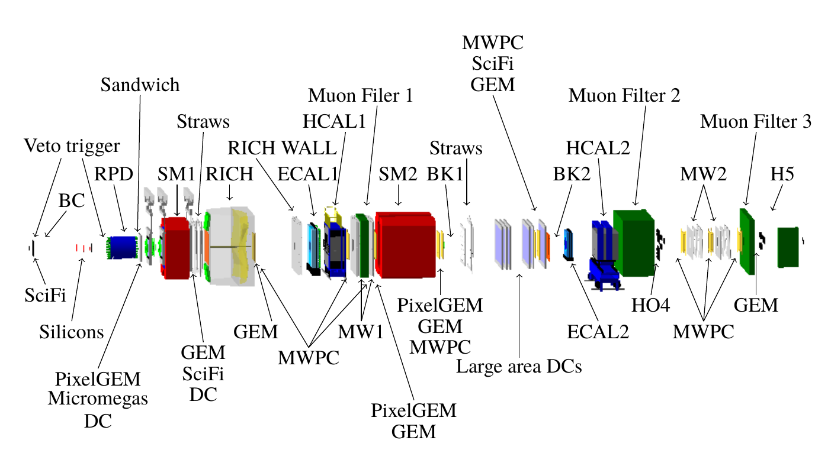
Detector Layout
Target

Slide 4
Structure of data storage
Run Number:
... | 69696 | 69697 | 69698 | ... | ... | 70161 | 70162 | 70163 | ...
Spill Number:
... | 3 | 4 | 5 | ... | ... | 188 | 189 | 190 | ...
Events:
... | event 100 | event 101 | event 102 | ... | ... | event 32001 | event 32002 | event 32003 | ...
Particles, tracks, vertices, recoiled protons...

Slide 5
Datasets and pre-selection:
Datasets info:
Year | 2008
Week | Week 33, 35, 37
Run number | 69595 ~ 70963
Conditions of filtering
A best primary vertex was found
Primary vertex Z-position Z_pv: -200 cm < Z_pv < 160 cm
Exactly one or three charged tracks, leaving the primary vertex
Charge sum of all three tracks = -1

Slide 6
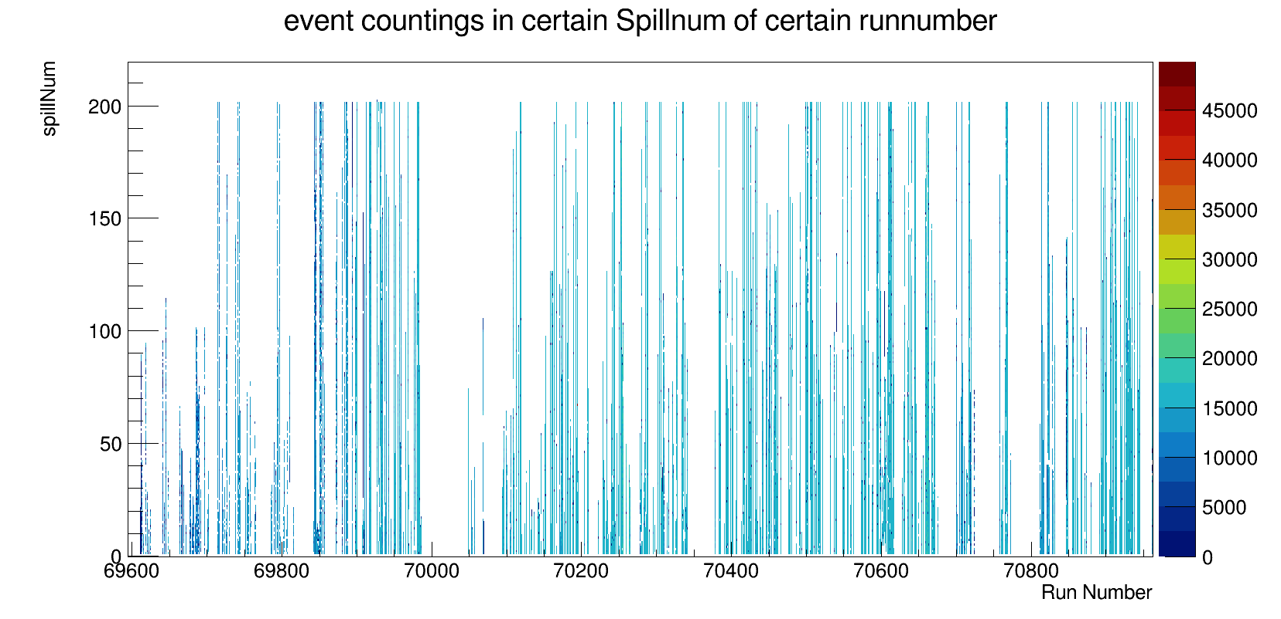
Overlook of event distribution

Slide 7
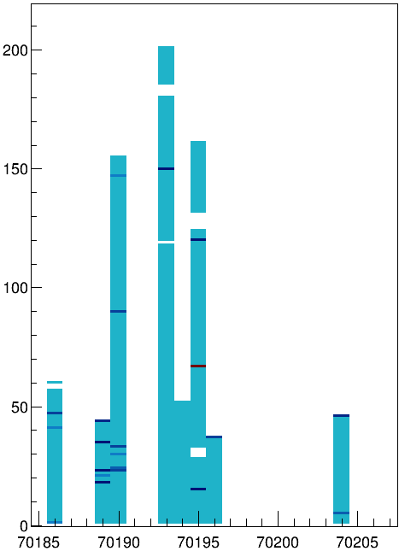
Overlook of event distribution

Slide 8
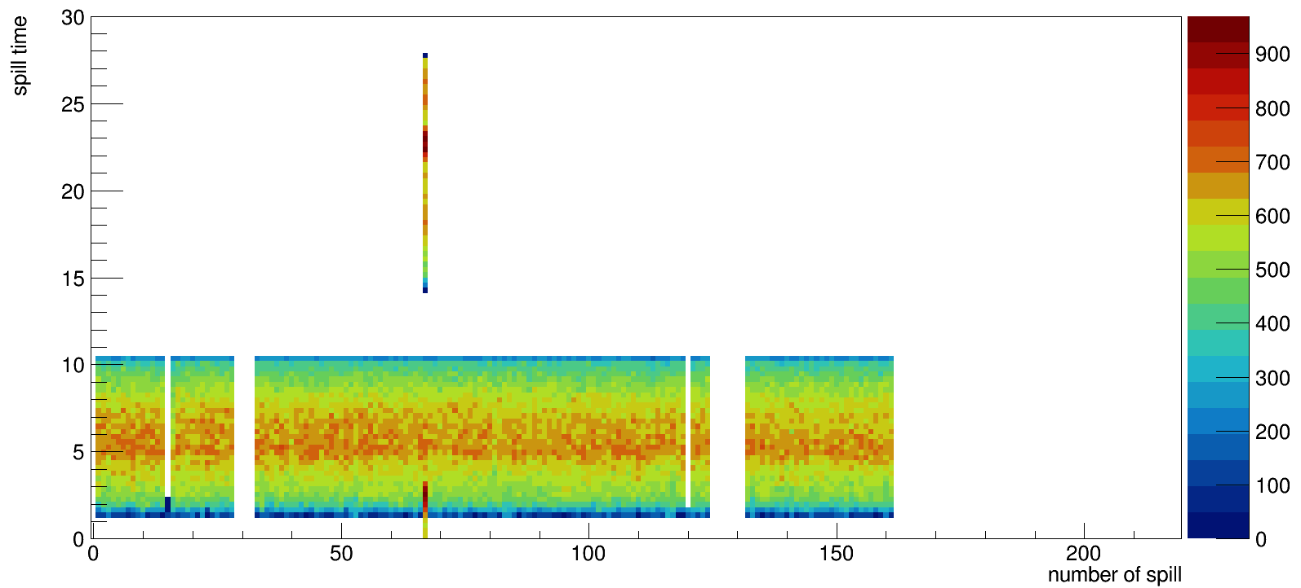
Event distribution of each spill ( Run = 70195)
Spill number

Slide 9
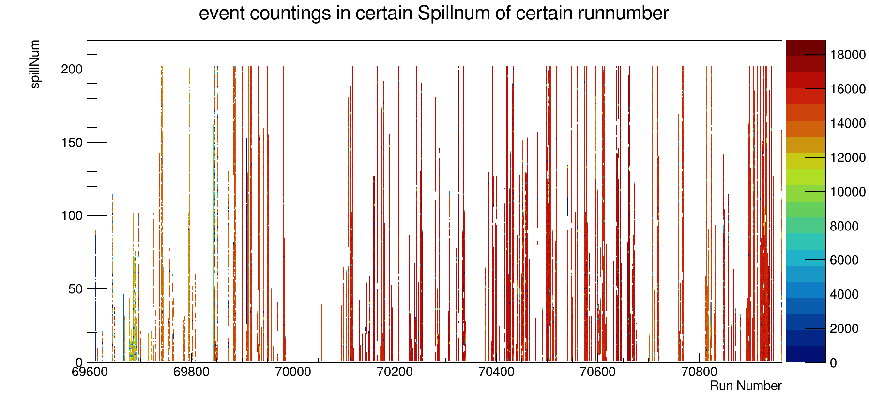
Overlook of event distribution

Slide 10
Parameters investigated
Invariant mass of three pions
Photon number from different Calorimeters
The total invariant mass
Angular distribution of recoiled proton
The FWHM width of invariant mass histogram

Slide 11
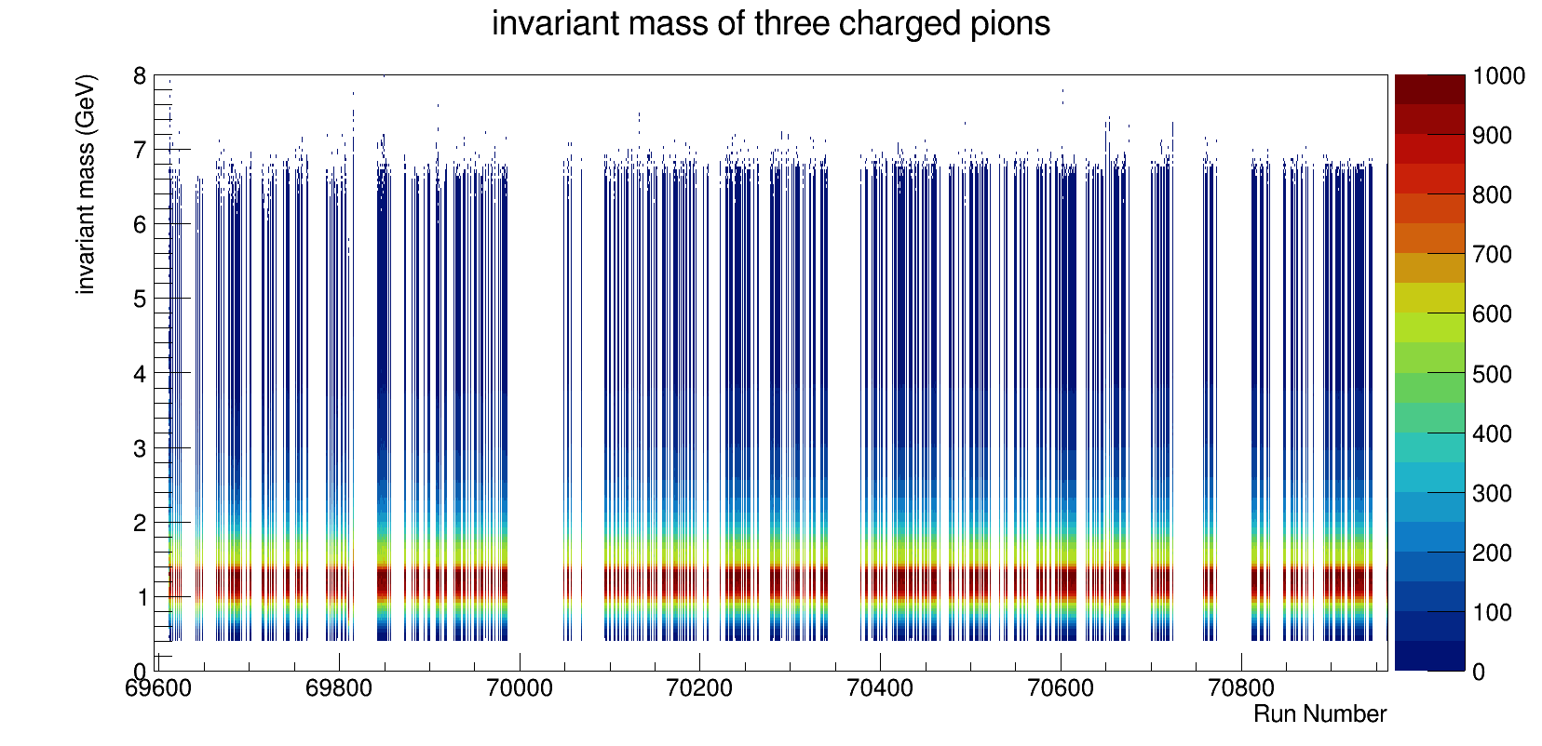
Invariant mass of 3 pions (Normalized)

Slide 12
Invariant mass of 3 pions (Normalized)
Projection of y at x =69853

Slide 13
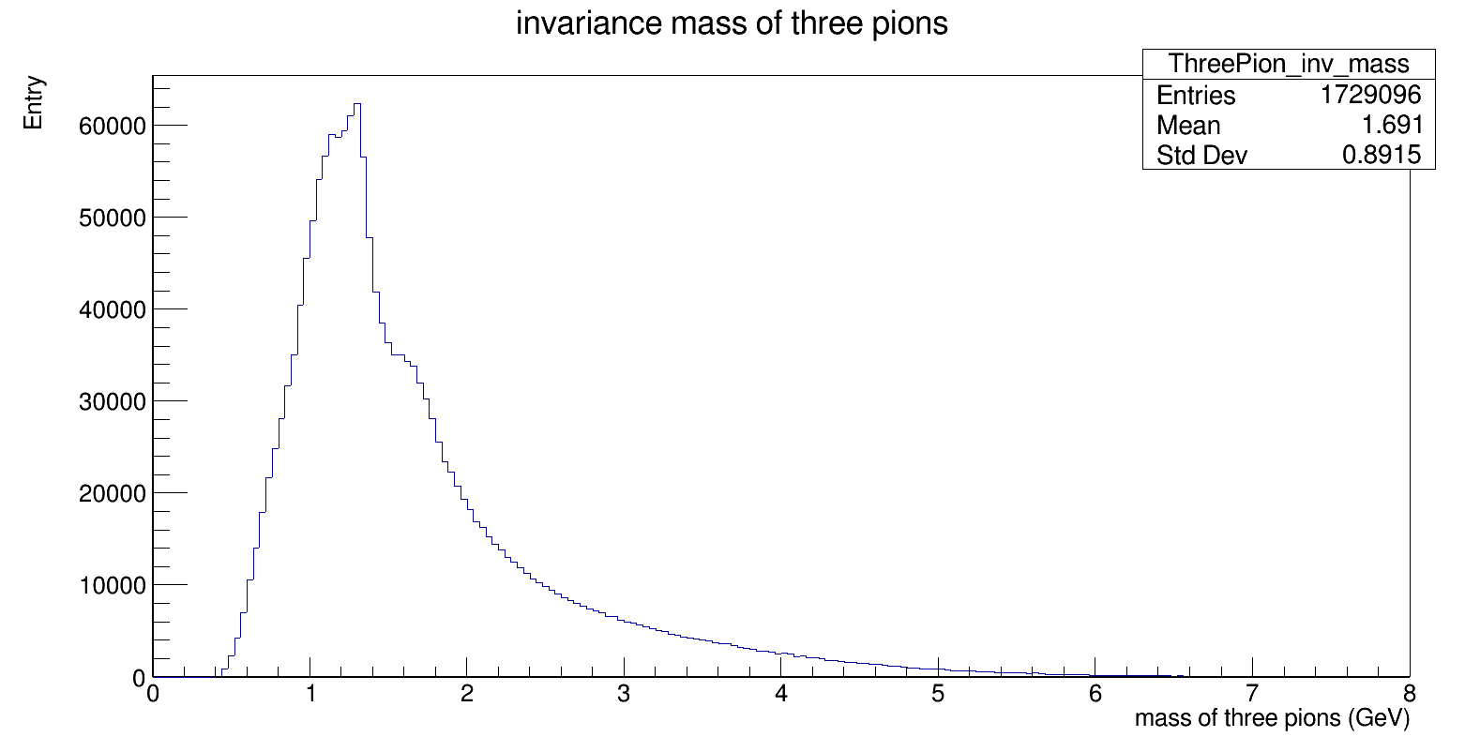
Invariant mass of 3 pions( Run = 69853)

Slide 14
Invariant mass of 3 pions( Run = 69853)
55% of maximum
1.32
1.67

Slide 15
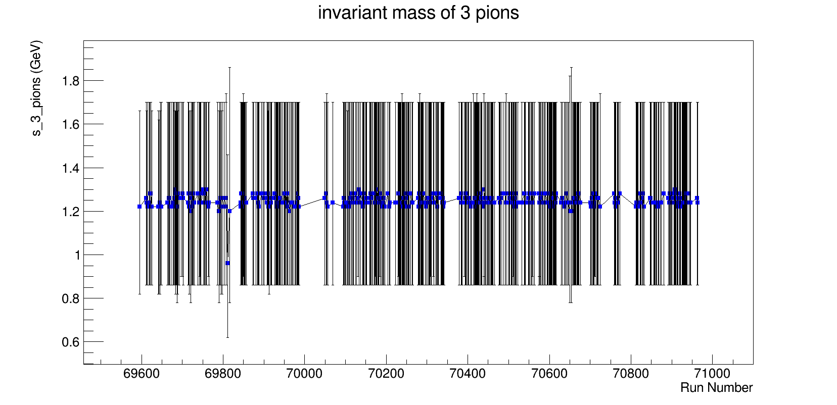
3 pions invariant mass

Slide 16
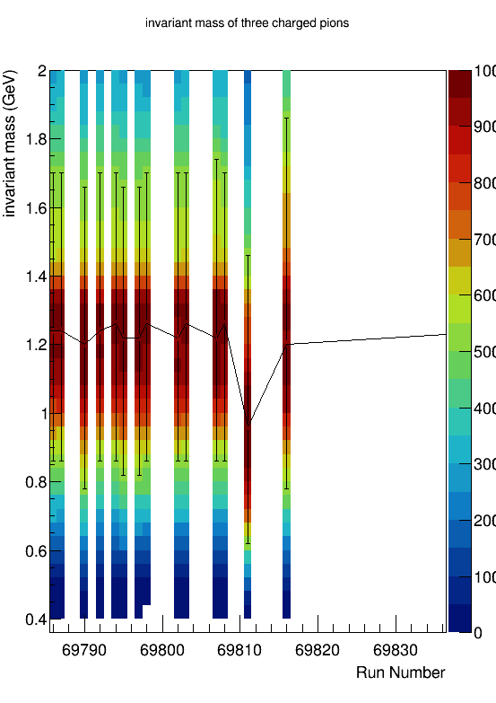
3 pions invariant mass

Slide 17
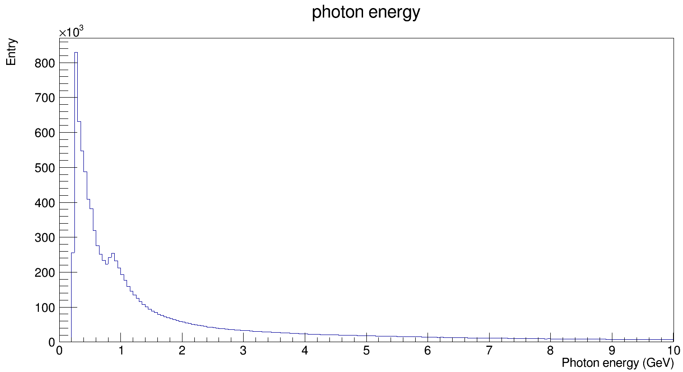
Photon energy ( Run = 69853)

Slide 18
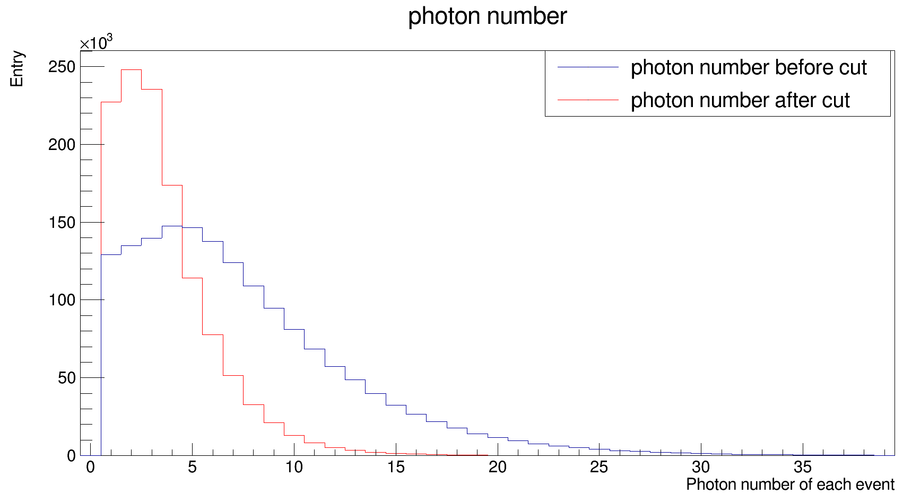
Photon energy cut ( Run = 69853)
Cut condition:
Calorimeter | Energy
ECAL1 | >1 GeV
ECAL2 | >4 GeV

Slide 19
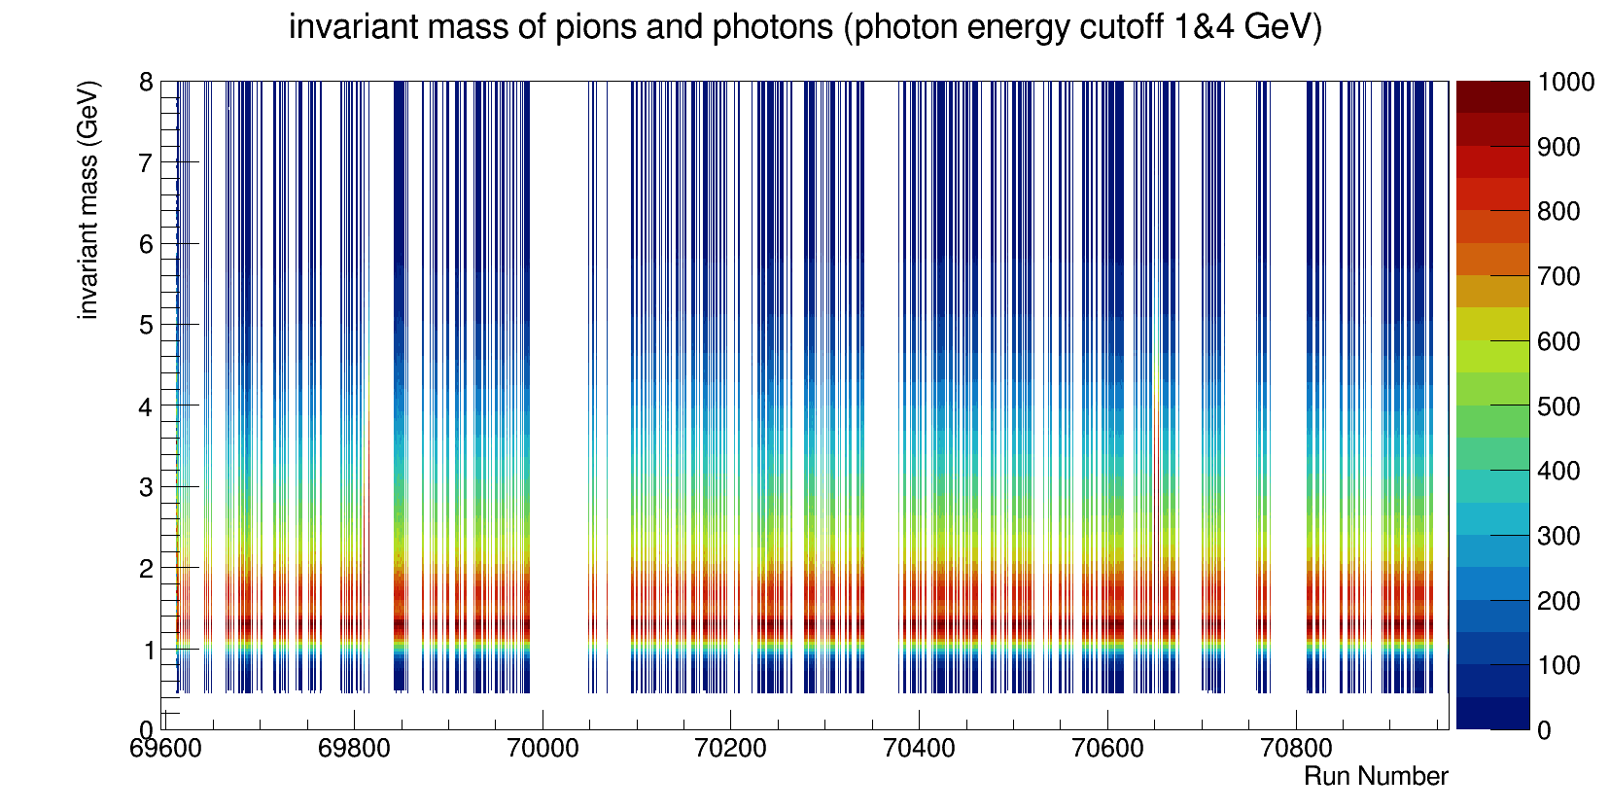
The total invariant mass (normalized)

Slide 20
The total invariant mass (normalized)
Projection of y at x =69853

Slide 21
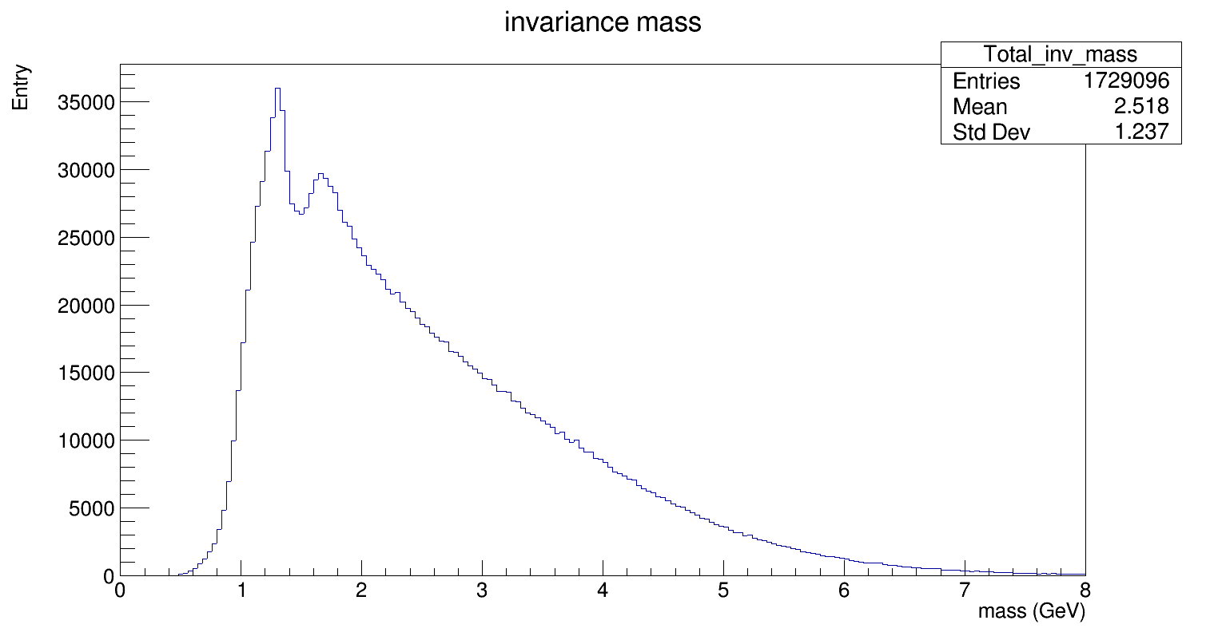
The total invariant mass ( Run = 69853)
1.3
1.6

Slide 22
The total invariant mass (normalized)
Projection of y at x =70650

Slide 23
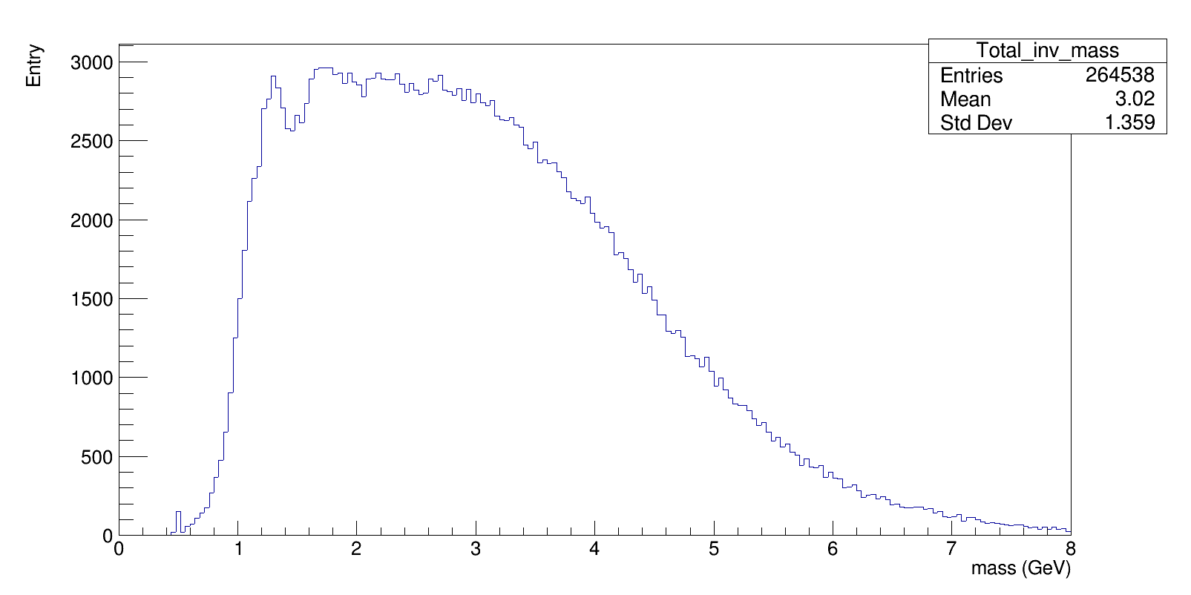
The total invariant mass ( Run = 70650)
FWHM ≈ 3.45 GeV

Slide 24
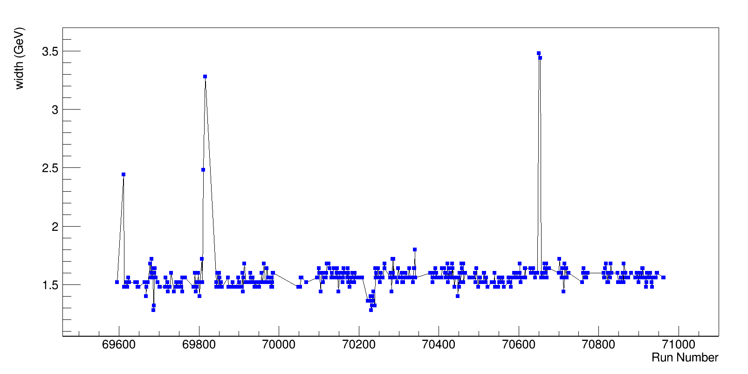
FWHM of total invariant mass

Slide 25
FWHM of total invariant mass

Slide 26
FWHM of total invariant mass

Slide 27
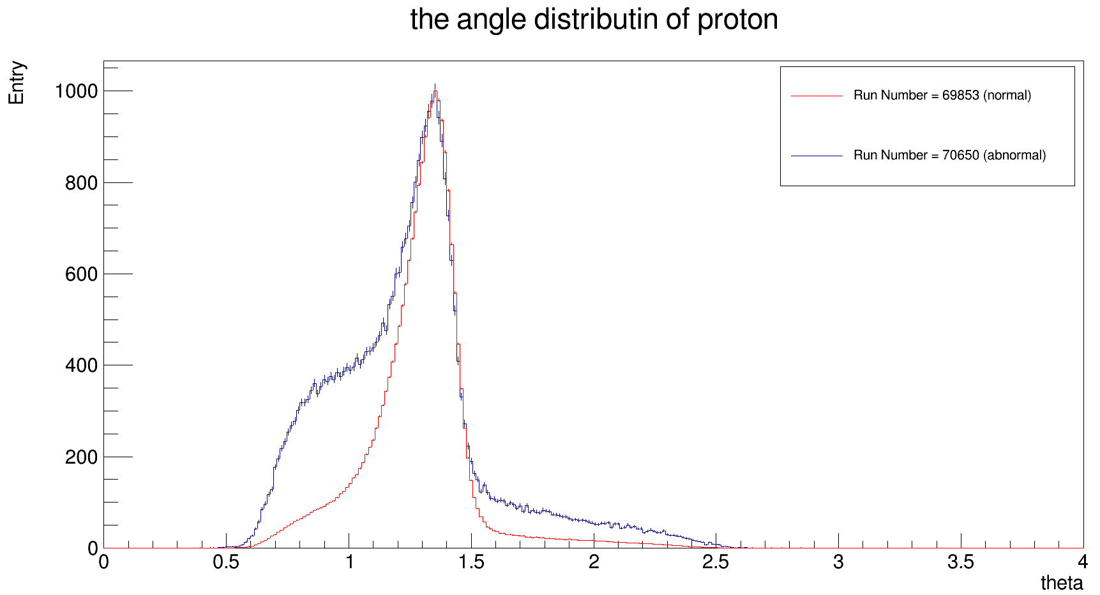
Recoiled Proton angular distribution
Width at 23% of maximum

Slide 28
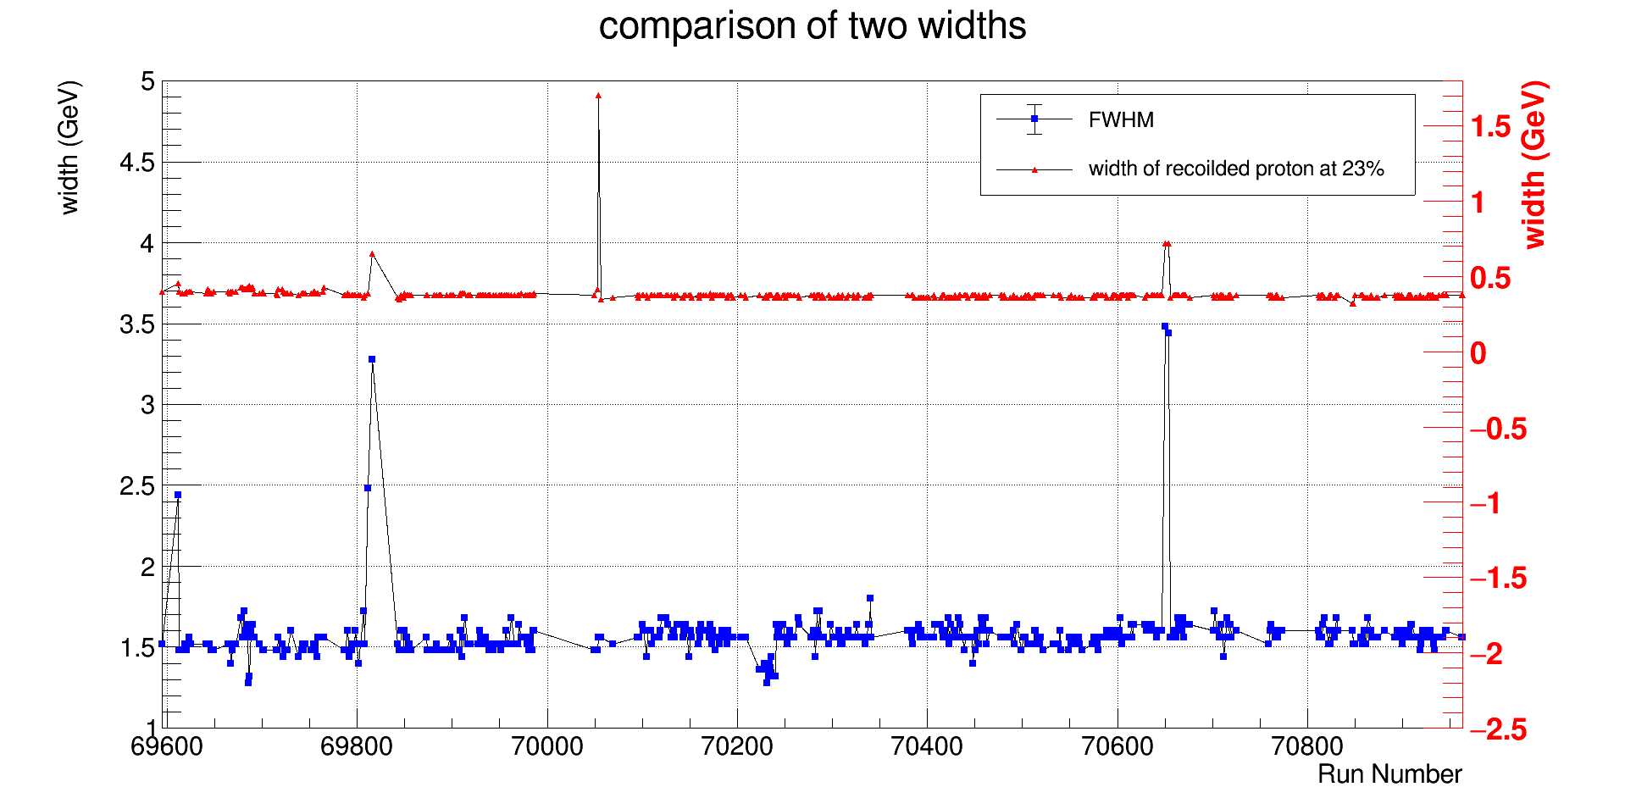
Comparison of widths from invariant mass and angles of recoiled proton

Slide 29
Comparison of widths from invariant mass and angles of recoiled proton
69612
69816
70650 ~ 70654

Slide 30
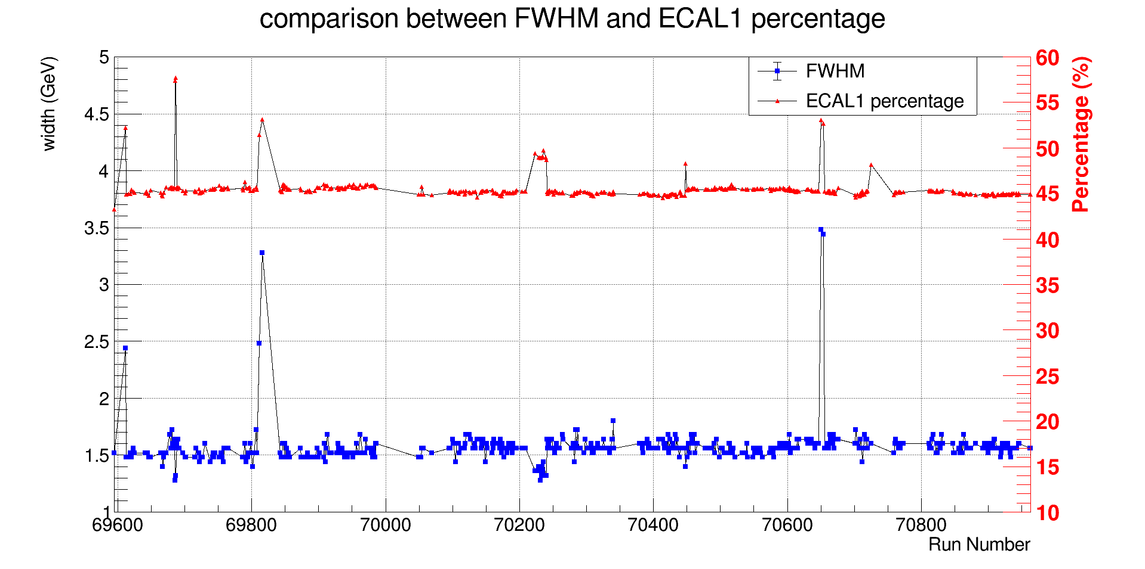
Comparison of ECAL1 percentage and FWHM of invariant mass

Slide 31
Comparison of ECAL1 percentage and FWHM of invariant mass
69696 ~ 69687
70223 ~ 70240
70448

Slide 32
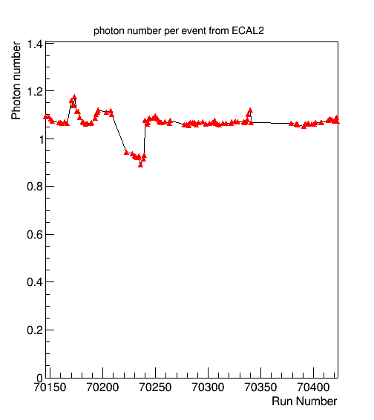
Comparison of ECAL1 percentage and FWHM of invariant mass
69696 ~ 69687
70223 ~ 70240
70448

Slide 33
Summary
Run number | Probable Cause | Log book/Comments
70195 | Disorder of Spill time | good
69612 | recoiled proton | N/A
69816 |  | no sandwich veto
70650 |  | triggers without sandwich veto, stopped due to MW1 errors
70654 |  | triggers without sandwich veto
69696 | decrease of number of photons from ECAL2 | detector test
69687 |  | N/A
70223 ~ 70240 |  | High voltage on ECAL2
70448 |  | CPS Booster problem

